Slide 1
Fundamentals of Machine Learning
(20B12CS331) Odd Semester 2022 (5th Semester )
Computer Science and Engineering and Information Technology
Jaypee Institute Of Information Technology (JIIT), Noida

Slide 2
Course Outcomes
At the end of this course, you will be able to :
COURSE OUTCOMES |  | COGNITIVE LEVELS
CO1 | Understand the mathematical concepts of machine learning approaches. | Understand Level (Level 2)
CO2 | Apply the fundamentals of linear algebra and probability theory to the machine learning problems. | Apply Level (Level 3)
CO3 | Apply the concepts of regression analysis and vector calculus to the machine learning models. | Apply Level (Level 3)
CO4 | Analyze the role of dimensionality reduction and density estimation for machine learning problems | Analyze Level (Level 4)
CO5 | Evaluate and test the significance of machine learning results statistically. | Evaluate Level (Level 5)

Slide 3
Course Outline
Module | Title of the Module | Topics in the Module | No. of Lectures
1. | Introduction to Machine learning | Why machine learning, learning problems, types of learning: supervised, unsupervised, semi-supervised learning, fundamentals of machine learning | 02
2. | Linear Algebra | Linear equations, solving linear equations, matrices, Cholesky Decomposition, singular value decomposition, matrix approximation, vector space, Norms, inner product, length and distances, angles and orthogonality, orthogonal complement, inner product, orthogonal projections and rotations, linear independence, linear mapping, Affine spaces | 09
3. | Probability Theory | Discrete and continuous probability, sum rule, product rule, Baye’s Theorem, Gaussian Estimation, conjugacy and exponential family, inverse transform, Hidden Markov model | 05
4. | Regression Analysis | Problem formulation, parameter estimation, linear regression vs non-linear regression models, univariate vs multivariate regression, regression using least squares, logistic regression in machine learning | 05

Slide 4
Course Outline
Module | Title of the Module | Topics in the Module | No. of Lectures
5. | Vector Calculus | Gradients of vector valued function, gradient descent learning, lagrange’s function in supervised learning, automatic differentiation, linearization and multivariate taylor series in machine learning | 07
6. | Dimensionality Reduction and Density Estimation | Maximum variance, Low rank approximation, PCA, ICA, LDA, latent Variable, GMM, Maximum Likelihood estimation, expected maximization machine learning | 08
7 | Statistical Validations | T test, paired T test, Z test, hypothesis testing, ANOVA, Pearson coefficient, significance testing | 06
Total number of Lectures |  |  | 42

Slide 5
Resources: Text Books/Reference Books
Text Books
1. | Goodfellow, Ian, Yoshua Bengio, and Aaron Courville. Deep learning. MIT press, 2016.
2. | Deisenroth, Marc Peter, A. Aldo Faisal, and Cheng Soon Ong. Mathematics for machine learning. Cambridge University Press, 2020.
Reference Books
1. | Mitchell, Tom M. "Machine learning." (1997).
2. | Bishop, Christopher M. Pattern recognition and machine learning. springer, 2006.
3. | Hastie, Trevor, Robert Tibshirani, and Jerome Friedman. The elements of statistical learning: data mining, inference, and prediction. Springer Science & Business Media, 2009.

Slide 6
Assessment / Marking Scheme
Component | Maximum Marks
T1 | 20
T2 | 20
End Term Examination | 35
TA (breakup below) | 25
Attendance | 10
Project based Learning (PBL) | 10
Qui/Assignments | 5
Total | 100

Slide 7
Machine Learning: An Introduction
Machine learning is about designing algorithms that automatically extract valuable information from data
or
A machine learning algorithm is an algorithm that is able to learn from data.
“Learning is any process by which a system improves performance from experience.” - Herbert Simon

Slide 8
Machine Learning: An Introduction
Definition by Tom Mitchell (1998): Machine Learning is the study of algorithms that:
improve their performance P
at some task T
with experience E.

Slide 9
Machine Learning: An Introduction
General Tasks
Classification, Regression, Machine Translation, Anomaly detection, etc.
Performance measures
Depends on the type of problem.
Examples include accuracy, error rate, etc.
Performance is measured on a dataset called test dataset, that is different from the dataset used to train the algorithms.
Experience
Algorithms are termed as supervised learning or unsupervised learning algorithms based on the experience they are allowed to have during the learning process.

Slide 10
Machine Learning: An Introduction
Example: Handwriting Recognition Learning Problem
Task T: Recognition and classifying hand written words within images
Performance Measure P: Percentage of words correctly classified.
Training Experience E: A database of handwritten words with given classification

Slide 11
Machine Learning: An Introduction
Example: A robot driving learning problem
Task T: Driving on public four-lane highways using vision sensors
Performance Measure P: Average distance travelled before an error (as judged by human)
Training Experience E: A sequence of images and steering commands recorded while observing a human driver

Slide 12
Why Machine Learning?
Learning is used when:
Human expertise does not exist (navigating on Mars),
Humans are unable to explain their expertise (speech recognition)
Solution changes in time (routing on a computer network)
Solution needs to be adapted to particular cases (user biometrics)
Discover new knowledge from large databases

Slide 13
Application Areas of Machine Learning
Human Computer Interactions
Computer Vision
Gaming
Finance
Medical Science
Natural Language Processing
Space Exploration
Robotics
Industry Automation
Social networks
and others…

Slide 14
Applications of Machine Learning
Object Detection

Slide 15
Applications of Machine Learning
Image Segmentation

Slide 16
Applications of Machine Learning
Image Colorization
Source: https://arxiv.org/abs/1603.06668

Slide 17
Applications of Machine Learning
Photo-realistic Style Transfer
Source: https://arxiv.org/abs/1703.07511

Slide 18
Applications of Machine Learning
Object Removal
Source: http://hi.cs.waseda.ac.jp/ iizuka/projects/completion/en/

Slide 19
Applications of Machine Learning
Image Completion
Source: http://hi.cs.waseda.ac.jp/ iizuka/projects/completion/en/

Slide 20
Applications of Machine Learning
Machine Translation

Slide 21
Applications of Machine Learning
Seq2SQL: Generating Structured Queries from Natural
Source: https://arxiv.org/abs/1709.00103

Slide 22
Applications of Machine Learning
Chatbots: Chatbots use ML to understand what a human wants, and guides them to their desired outcome.
Source: https://blog.drift.com/chatbots-report/

Slide 23
Applications of Machine Learning
Code generation by image
Source: https://arxiv.org/abs/1705.07962

Slide 24
Applications of Machine Learning
Speech Recognition: Word Error Rate (WER)
Google Pixel Buds
Amazon Echo
Source: https://venturebeat.com/2017/05/17/googles-speech-recognition-technology-now-has-a-4-9-word-error-rate/

Slide 25
Applications of Machine Learning
Drone control
Source: http://www.digitaltrends.com/cool-tech/swiss-drone-ai-follows-trails/

Slide 26
Types of Learning
Supervised (inductive) learning
Given: training data, desired outputs (labels)
Unsupervised learning
Given: training data (without desired outputs)
Semi-supervised learning
Given: training data + a few desired outputs
Reinforcement learning
Given: rewards from sequence of actions

Slide 27
Supervised Learning
We collect lots of examples with their known outcomes
Learn a function that map inputs to outputs
Supervised Learning models are trying to find parameter values that will allow them to perform well on historical data.
Then they are used for making predictions on unknown data, that was not a part of training dataset.

Slide 28
Supervised Learning
Given (x1, y1), (x2, y2), ..., (xn, yn)
Learn a function f(x) to predict y given x
There are two main problems that can be solved with Supervised Learning:
Classification
Regression
Examples of Supervised Learning
Cortana
Google Assistant / Siri
Biometric Identifying

Slide 29








Supervised Learning: Regression
Given (x1, y1), (x2, y2), ..., (xn, yn)
Learn a function f(x) to predict y given x
y is real-valued
9
8
7
6
5
4
3
2
1
0
1970 1980
September Arctic Sea Ice Extent (1,000,000 sq km)
1990
2000
2010
2020
Year
Source: G. Witt. Journal of Statistics Education, Volume 21, Number 1 (2013)

Slide 30










Supervised Learning: Classification
Given (x1, y1), (x2, y2), ..., (xn, yn)
Learn a function f(x) to predict y given x
y is categorical
Breast Cancer (Malignant / Benign)
1(Malignant)
0(Benign)
Tumor Size

Slide 31
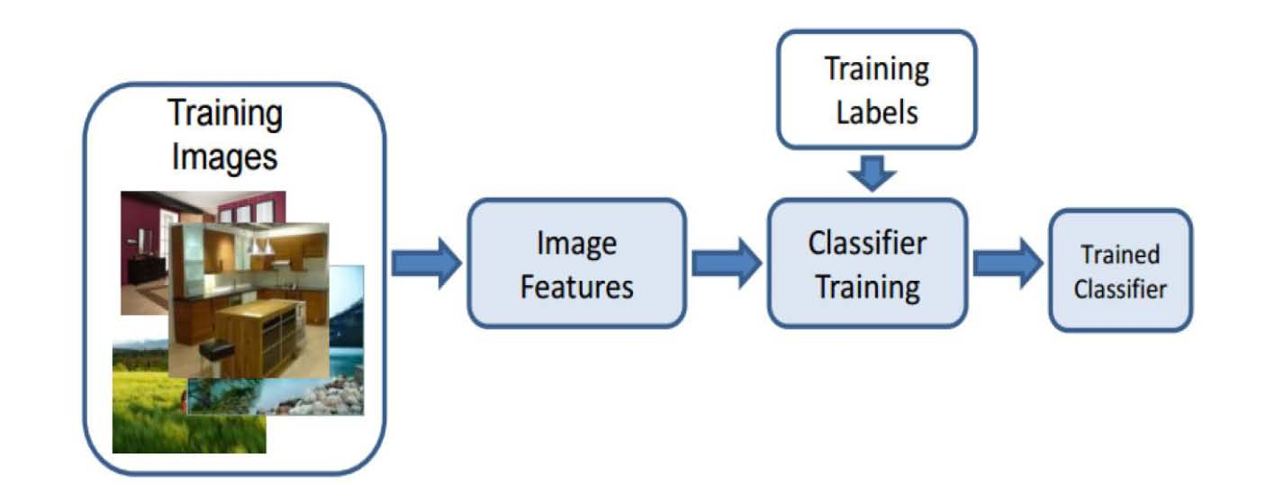
Supervised Learning: Classification

Slide 32
Unsupervised Learning
Draw inferences from non-labeled data (without reference to known or labeled outcomes)
Models based on this type of algorithms can be used for discovering unknown data patterns itself

Slide 33
Reinforcement Learning
Reinforcement learning is a type of machine learning where an agent learns to behave in a environment by performing actions and seeing the results.
Examples:
Game playing
Robot in a maze
Balance a pole on your hand

Slide 34
Semi-Supervised Learning
This learning technique uses labeled as well as unlabeled data.
Label data is in small quantity while un-labeled data is in large amount.
First un-supervised algorithm forms groups (clusters) of un-labeled data and then existing labeled data is used to label the clustered un-labeled data.
Elements closer (similar) to each other are more likely to have the same output label.

Slide 35
Example
Supervised learning
Faculty supervision all the times
Unsupervised learning
student has to figure out a concept himself
Semi-Supervised learning
SL: faculty teaches some concepts in class
SSL: student solves homework questions based on similar concepts taught by faculty in class.

Slide 36
Fundamentals of Machine Learning
Major components of a machine learning system
Data
Models
Learning
Evaluation
Preprocessing
Noise Filtering/ Feature Extraction/ Normalization
Environment/ real world
Sensors/ cameras/ Databases
Dimensionality Reduction
Feature Selection
Model Learning
Classification/ Clustering
Model Testing
Result Analysis

Slide 37
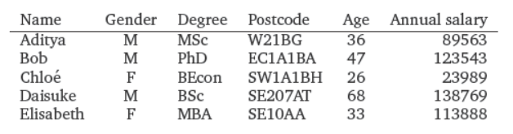
Fundamentals of Machine Learning
Data
Data is assumed to be tabular
One Feature
One instance
Source: Deisenroth, Marc Peter, A. Aldo Faisal, and Cheng Soon Ong. Mathematics for machine learning. Cambridge University Press, 2020

Slide 38
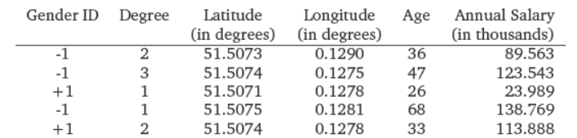
Fundamentals of Machine Learning
Data
Data is assumed to be tabular
Data should be represented adequately in a numerical format
Each input x_{n} is a D-dimensional vector of real numbers, which are called features, attributes, or covariates.
Representing data as vectors x_{n} allows us to use concepts from linear algebra
Source: Deisenroth, Marc Peter, A. Aldo Faisal, and Cheng Soon Ong. Mathematics for machine learning. Cambridge University Press, 2020

Slide 39
Fundamentals of Machine Learning
Models as a Functions / Probability Distributions
After an appropriate vector representation of data, we have to construct a predictive function (known as a predictor).
Predictor can be taken as a function or as a probabilistic model
A predictor as a function produces an output for a given input example (vector of features)
In case of uncertainty, predictors are used as a probabilistic model

Slide 40
Fundamentals of Machine Learning
Various Model Representation
Numerical functions
Linear regression
Neural networks
Support vector machines
Symbolic functions
Decision trees
Rules in propositional logic
Rules in first-order predicate logic
Instance-based functions
Nearest-neighbor
Case-based
Probabilistic Graphical Models
Naïve Bayes
Bayesian networks
Hidden-Markov Models (HMMs)
Probabilistic Context Free Grammars (PCFGs)
Markov networks

Slide 41
Fundamentals of Machine Learning
Learning
The goal of learning is to find the selected model’s parameters such that the resulting predictor will perform well on unseen data.
Various Search/Optimization Algorithms
Gradient descent
Perceptron
Backpropagation
Dynamic Programming
Hidden Markov Model (HMM)
Learning
Probabilistic Context-Free
Grammar (PCFG) Learning
Divide and Conquer
Decision tree induction
Rule learning
Evolutionary Computation
Genetic Algorithms (GAs)
Genetic Programming (GP)
Neuro-evolution

Slide 42
Fundamentals of Machine Learning
Evaluation
Accuracy
Precision and recall
Squared error
Likelihood
Cost
Entropy
and others

Slide 43


ML in Practice
Understand domain, prior knowledge, and goals
Data integration, selection, cleaning, pre-processing, etc.
Learn models
Interpret results
Consolidate and deploy discovered knowledge
Loop
Based on a slide by Pedro Domingos

